Slide 1
The practice of curating big datasets
Tim Hannigan, University of Alberta Hovig Tchalian, Claremont Graduate University, Drucker School of Management Laura Nelson, College of Social Sciences and Humanities Northeastern University Jason Kiley, Oklahoma State University

Slide 2
Data Curation: Today’s Agenda
Motivation for our workshop
Process & Philosophy
Demo: NYTimes API
Takeaways
Q&A

Slide 3
Motivation: an intersection of two trends
Data management is getting more complex than in the past.
Bigger data, more datasets, more complex transformations.
Higher costs for bad practices and more payoff for good practices.
Reproducibility is important for good science.
The Atlantic: The Scientific Paper is Obsolete.
Traditional formats were not designed for our reliance on computation.
Newer tools (e.g., notebooks) better match what we actually do.
Reproducibility is partly for you at another point in time.
Notes:
Data is becoming more complex, and it’s becoming harder to communicate. Newer tools can improve how we perform studies and how we communicate them.
Let’s not forget pragmatism. No one requires you to publish your notebooks. Yet. However, you can be more effective and efficient in the current system, while being better prepared for something like what is likely next.

Slide 4
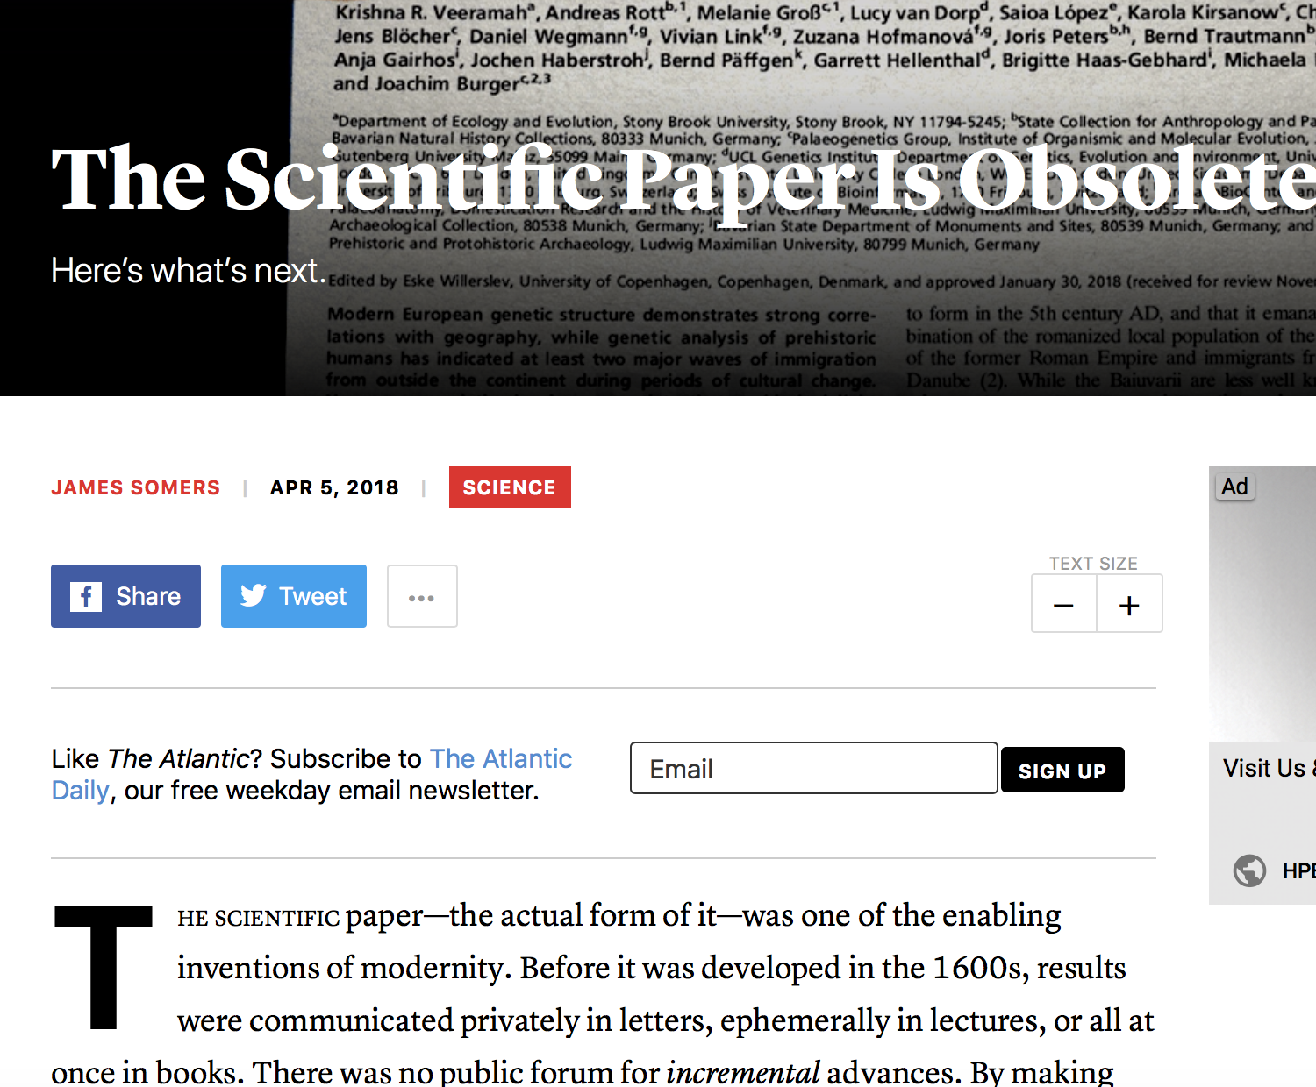
The future of journal publishing?
Source: https://www.theatlantic.com/science/archive/2018/04/the-scientific-paper-is-obsolete/556676/
Notes:
Some people have suggested a radical solution – getting rid of scientific papers

Slide 5
“New Archivalism” (Ventresca & Mohr, 2002) predicted the blended computational/interpretive approach
reliance on formal analytic methodologies
focus on the measurement of social organization and its constituent elements rather than on organizations themselves
emphasis on the study of relations rather than objects or attributes
concern with measuring the shared forms of meaning that underlie social organizational processes and finally
interest to understand the configurational logics that tie these various elements together into organized activity
Ventresca, M., & Mohr, J. W. 2002. Archival research methods. (J. A. C. Baum, Ed.)Blackwell Companion to Organizations, 805–828.
Notes:
Ventresca & Mohr 2002 set the precedent

Slide 6
New research methods require data management
Data management (or curation) is a process of transforming data from an initial, raw state into a research-appropriate state.

Slide 7
Motivation: has this happened to you?
In the middle of a project, you inherited primary responsibility for the data
For some important variable, you could never reproduce how it was gathered or calculated.
A reviewer asked for some robustness check that requires changes to an intermediate stage in building your dataset
So you had to redo much of the work.
A student assembled the dataset
And you would like to look over what was done and make suggestions.
Notes:
In a recent project, I was expanding a dataset. I pulled several measures of a particular variable, and all of them were only correlated at 0.65 to 0.75 with the existing (undocumented) measure of the same thing. It should have been 0.99 or 1 with one of them.
I see this a lot when we have some consolidated measure of something, and they want certain categories recoded/excluded/split out/aggregated over a different time span.
On a recent project, a really good student went back to fix something and needed more than a week. We paused, spent three weeks (not at 100 percent) applying this philosophy, and now changes happen in an hour or two. That’s huge in a revision timeline.

Slide 8
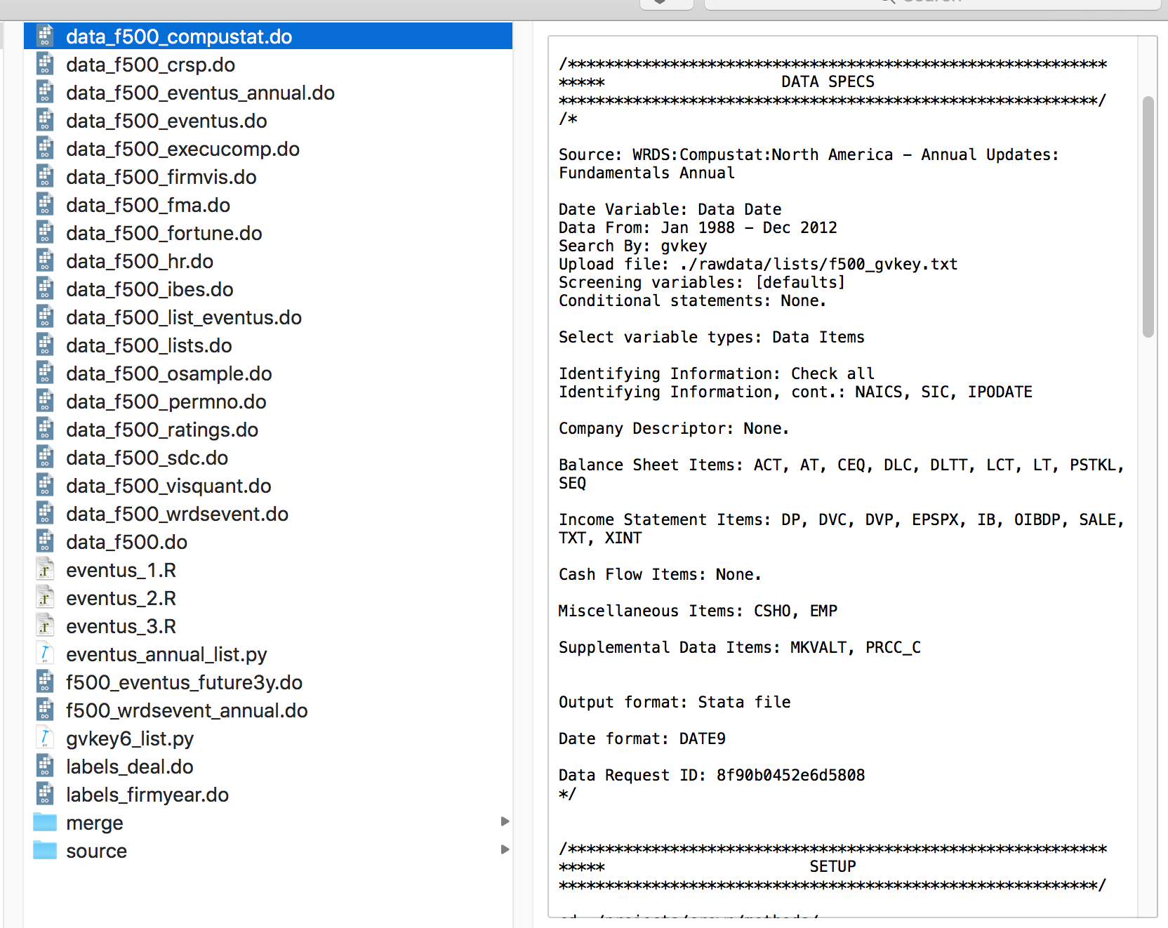
Data source
Notes:
Process:
Generate lists
Feed those into a data source
Save that source data
(Also) Document data specs
Make a prep script for that one data source (remember the one dataset limitation)
Save a ready-to-merge version of that data.
Repeat a lot!
Have one script merge all of that together into your clean data.
Or, one notebook that does most of that other than pulling the source data (but does store the documentation).

Slide 9
Today’s Demo
Data Access
Data Selection
Data Cleaning
Data Analysis
Fetch the data
NYTimes
Create dataframe
Deploy Pandas
Save archive of raw data
Merge data
Validate
Summarize
Content Analyze
Use NLTK
Visualize

Slide 10
200 charging stations in U.S.
Spike in expert discs. (13-25%)
GM Impact announced
12k charging stations in U.S.
First Roadster prod. model
First EV1 prod. model
Tesla Roadster announced
Notes:
Setting the context; we’re going to be looking a a dataset; we’re not going to reproduce this, but we’re going to create a dataset that looks at the last 10 years of this

Slide 11
Demo
Notes:
For a good hour

Slide 12
Philosophy
Others (and you) should be able to reproduce your study.
Data management errors happen, and you should be able to detect and repair them easily.
Data management is iterative and ongoing, and practices should be designed to match this nonlinear flow.
Good data tools are built well once and used repeatedly.

Slide 13
Process
Cliché (but true): 80% of data-intensive research focuses on data curation / wrangling
Highly iterative with four interrelated stages:
Access
Cleaning
Selection
Analysis
Overall goal: move from the data we can get toward data that we can use to examine our theoretical questions.

Slide 14
Implications (1)
You should be thoroughly familiar with the data you gather.
All changes to pulled data should be in code that runs.
When developing your code (and after), you should look at the data often.
Your data should always be built by running your code as-is.
Notes:
Know your data: what’s in it, what it’s issues are, how (specifically) it was gathered.
Know what you did: code is a great way to document changes.
Know that your code and expectations match.
Know that your code is authoritative: only build your dataset by running the code start to finish.

Slide 15
Implications (2)
When naming your clean dataset, use a name that uniquely identifies it (e.g., 20180418_workshop.dta).
Use file-sharing services (e.g., Dropbox) for distribution and storage, not work-in-progress files.
(More advanced) Capturing your known good code to reuse makes future projects better.
Advanced users can also benefit from the version-control capabilities of Git / Github.
Notes:
Simple versioning means that you know everyone on your team is using the same data.
Make it easy to work: don’t let Dropbox become a trash heap.
This is how software is built: write something well once and reuse it. Over time, you’re just stringing together well-made code.

Slide 16
Takeaways
Data management is a (disciplined) process
Easy-to-use tools are available for even the “uninitiated”
API access a great alternative to search / download and databases
SCOPUS article search is purpose-built for scholarly research
More interactive / “GUI” interfaces are on their way
No better time to jump in and use the tools and even ... learn Python
Notes:
It isn’t incredibly challenging to use data efficiently and effectively
The tools exist to help scholars – even ones new to data-intensive projects and / or computational methods
Doing so can save you the headache of having to redo analysis and, more important, the opportunity to know your data better and generate more insights

Slide 17
Q&A
We’re happy to take any questions

